Slide 1
Radioactive Decay

Slide 2
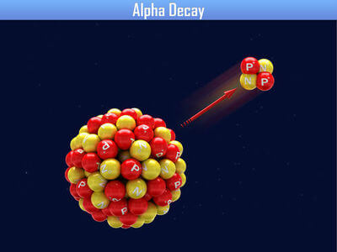
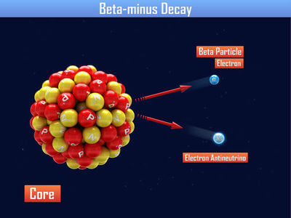
In this Smart Lesson you will learn to:
Explain how an excess of protons, neutrons or mass in a nucleus can result in alpha, beta positive and beta negative decay.
Symbolise alpha and beta particles.

Slide 3
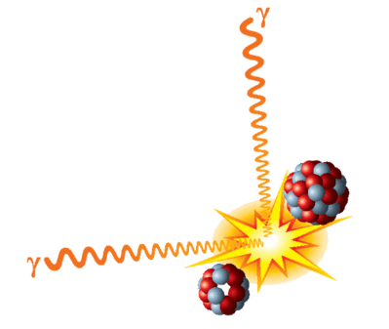
A nucleus is held together by strong nuclear forces.
These hold the protons and neutrons together, even though there is electrostatic repulsion between the protons.
If there is an excess of protons, neutrons or mass in a nucleus, it may be unstable.
Unstable nuclei tend to emit radiation to become more stable.

Slide 4
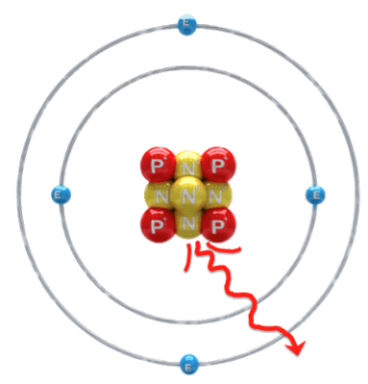
Radioactive atoms can emit alpha, beta, or gamma radiation.
The emission of alpha and beta radiation causes the parent atom to decay into a daughter atom.
Gamma radiation does not cause atoms to decay. However, it does lower the energy level of the atom. Gamma radiation has no mass or charge, only energy.

Slide 5
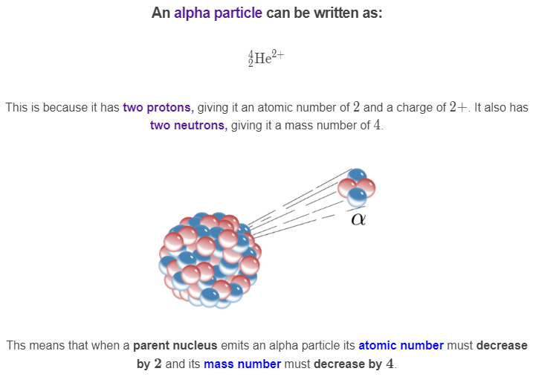

Slide 6
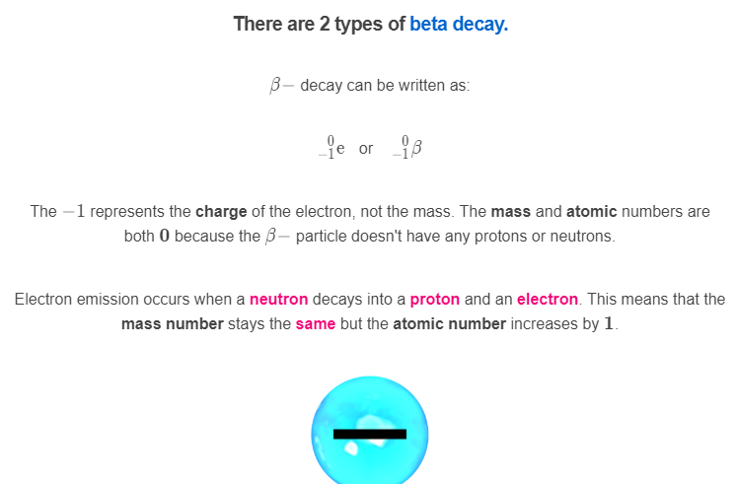

Slide 7
